Slide 1

BABU BANARASI DAS UNIVERSITY
AURA
AUTOMATED ROAD HEALTH ANALYZER
An intelligent edge computing platform that uses sensor fusion to automatically detect, classify, and report road hazards in real-time.

Slide 2
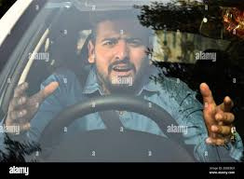
PAGE 02
THE PROBLEM: THE MANUAL PROCESS IS BROKEN
For Drivers: Hitting a pothole means worrying about damage, trying to remember a vague location, and filing a report that likely gets lost. It's a frustrating, manual process with no guarantee of a fix.
For Cities: Without accurate, real-time data on where and how severe road damage is, they cannot prioritize repairs effectively, leading to wasted resources and unsafe roads for everyone.

Slide 3
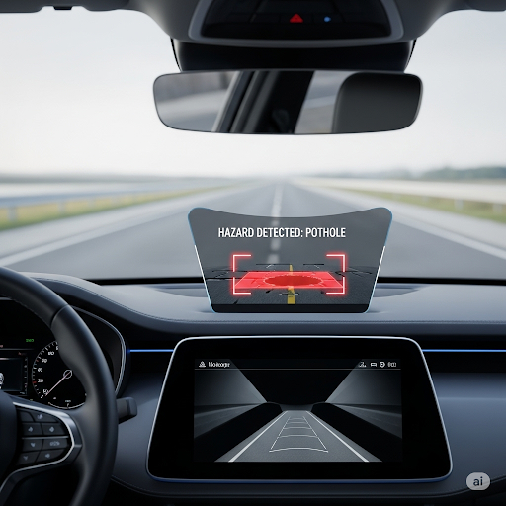
PAGE 03
SOLUTION: AN INTELLIGENT EDGE COMPUTING "BLACK BOX"
AURA is a smart hardware and App combination that connects to a vehicle's dashcam and impact sensors. It processes all sensor data locally, in real-time. When its AI model confirms a pothole, the "black box" sends only the essential result—a compact data packet containing the precise location, severity score, and a confirmation image—to our server. This efficient approach powers our driver-alert application and the city's hazard map without overwhelming data costs.
ARTIFICIAL INTELLIGENCE
01
Computer Vision
CNN
HARDWARES
02
Raspberry PI
Mpu6050
Uttrasonic Sensor
Camera Module/Dashcam
Microphone

Slide 4
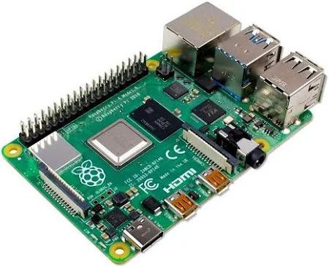
PAGE 04
SENSING THE STREETS: THE EYES & EARS ON THE ROAD
Our intelligent "black box" unit acts as the vehicle's co-pilot, constantly scanning the environment. It uses a dashcam for its "eyes" and a high-precision impact sensor for its "ears," capturing a complete picture of the road surface and vehicle dynamics in real-time.
A model is trained to verify the sound caused by pothole for double verification.
01

Slide 5
PAGE 05
THE ONBOARD BRAIN: INSTANT ANALYSIS AT THE EDGE
01
PRIVACY BY DESIGN
This is where the magic happens. Instead of sending massive video files to the cloud, our device processes all data locally. Its powerful AI engine analyzes the feed on the spot, making instant decisions and distinguishing real threats from false alarms.
02
ZERO-LATENCY DECISIONS
03
BUILT FOR THE REAL WORLD
04
TWO STEP VERIFICATION

Slide 6

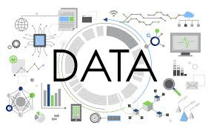
PAGE 06
THE WHISPER, NOT THE SHOUT: SMART DATA TRANSMISSION
Once a pothole is verified, the "black box" sends a tiny, efficient data packet to our server. This "whisper" contains only the critical information: the exact GPS location, a severity score, and a single confirmation image. This keeps data costs minimal and ensures the system is scalable.

Slide 7

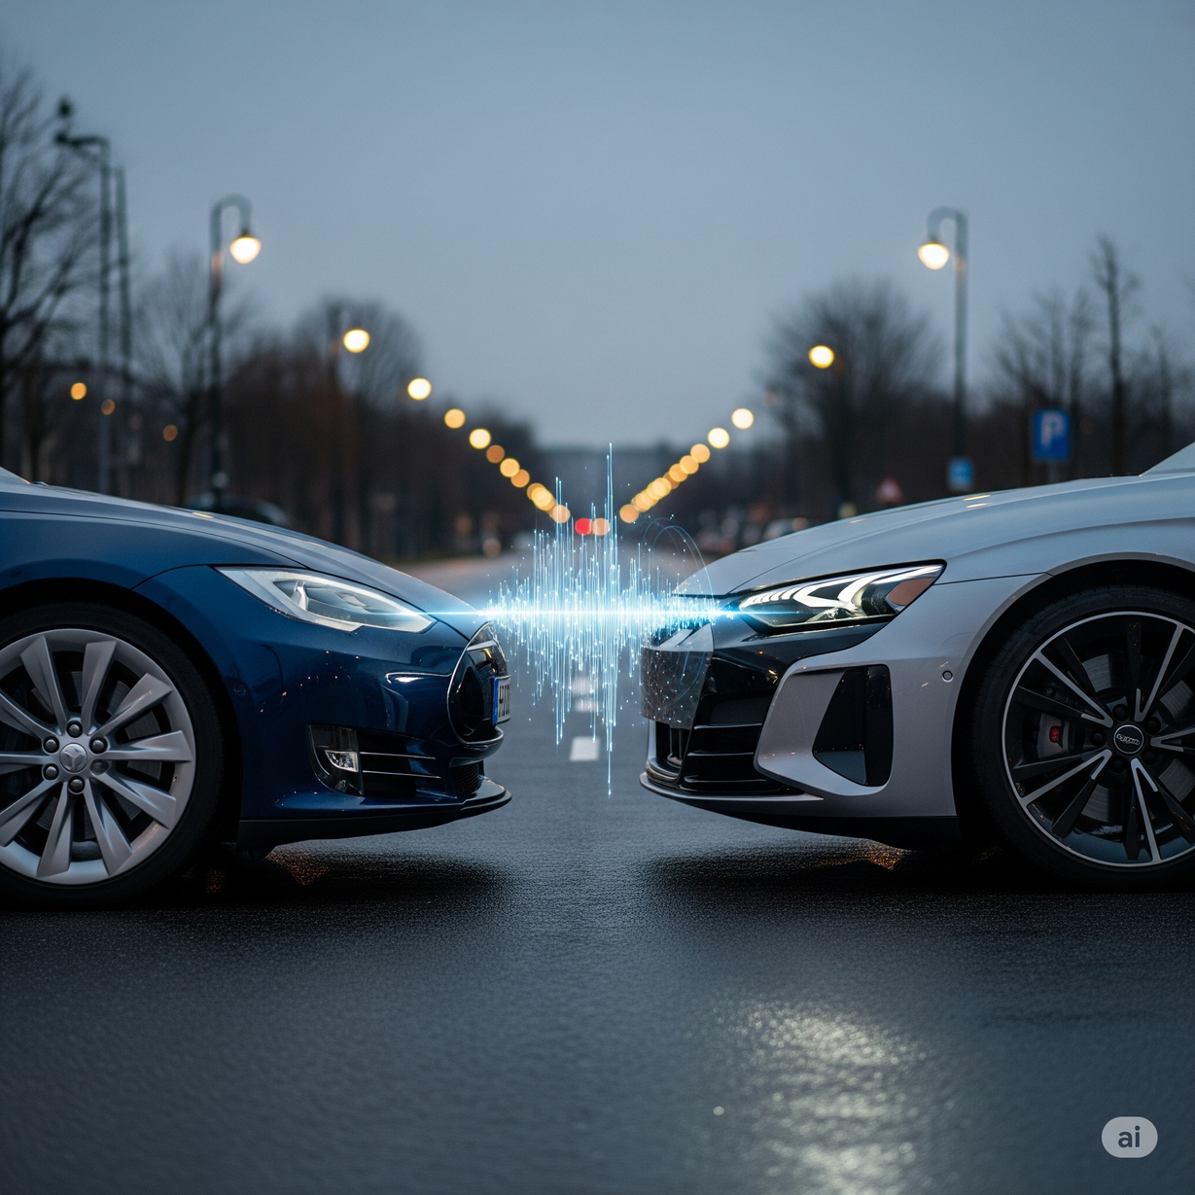
PAGE 07
CONNECTING THE DOTS: BUILDING THE LIVE HAZARD NETWORK
Our cloud platform receives these confirmed "whispers" from every vehicle in the network. It aggregates them instantly, weaving thousands of individual data points into a single, comprehensive, and live map of the city's entire road health

Slide 8
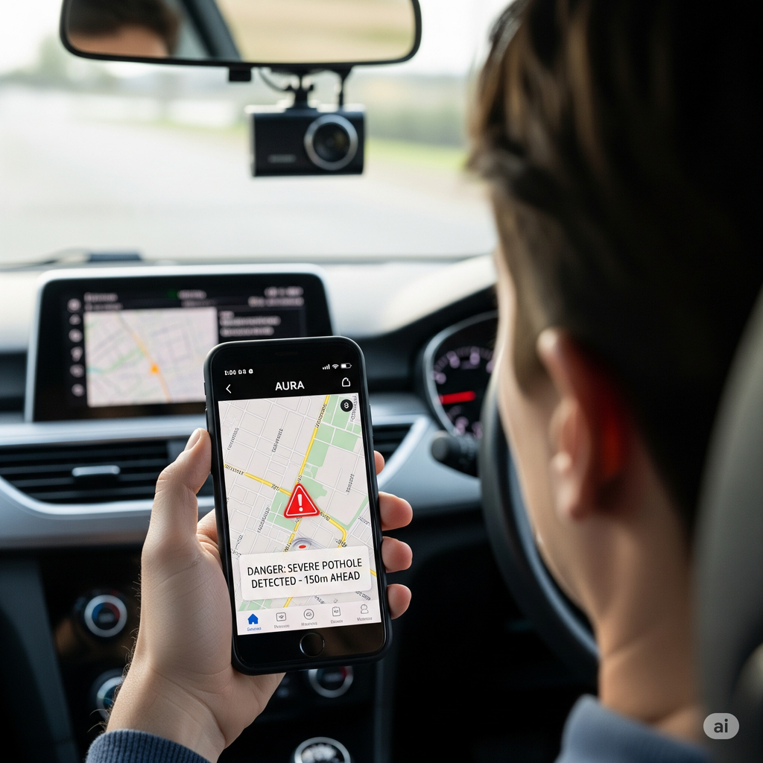
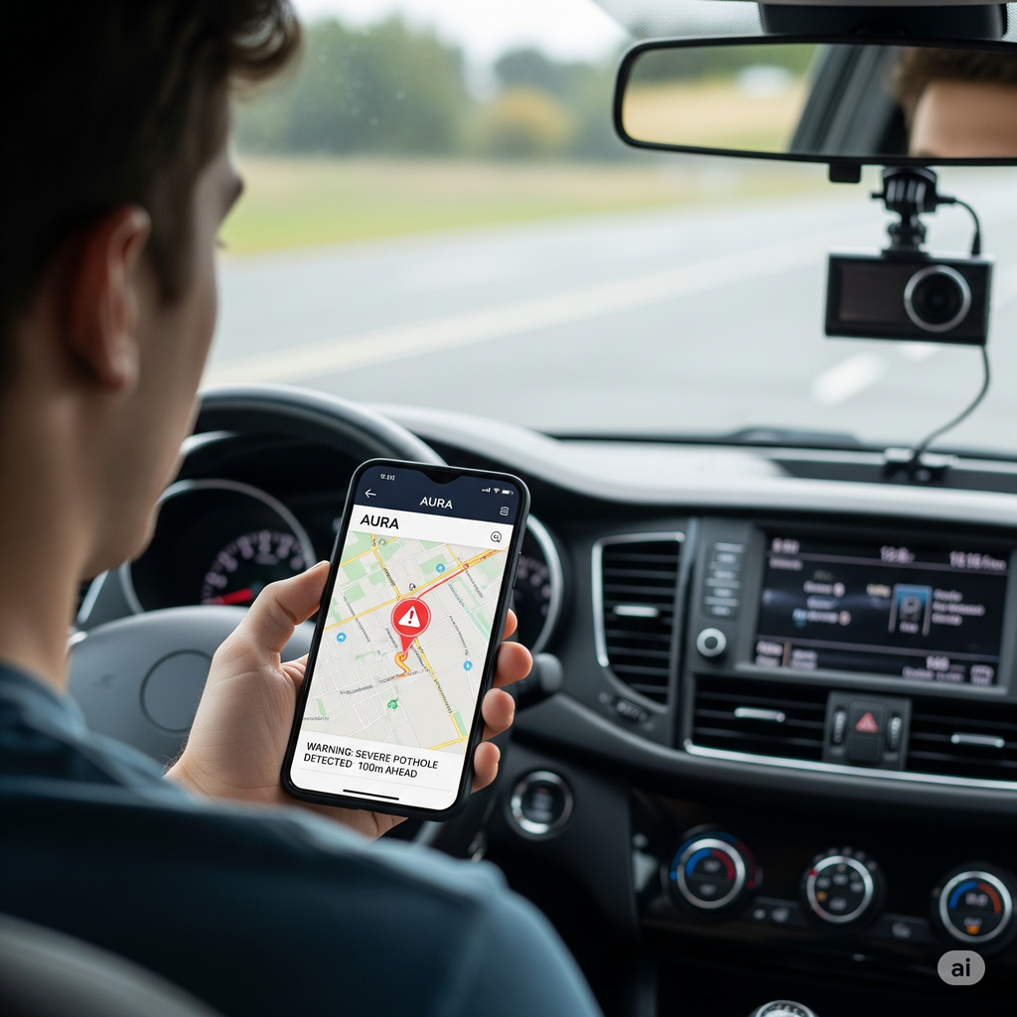
PAGE 08
CLOSING THE LOOP: FROM DATA
For Drivers: A mobile app that provides real-time voice and visual alerts for confirmed hazards ahead.
For Cities: A powerful dashboard that gives municipal engineers a prioritized, data-driven action plan to fix the worst problems first.

Slide 9
PAGE 09
BENEFITS
01
02
03
04
FOR DRIVERS
FOR MUNICIPALITIES
FOR BUDGETS
FOR EFFICIENCY
Increases driver safety with real-time alerts for upcoming potholes and hidden road hazards.
Enables data-driven road maintenance, allowing cities to fix the worst potholes first and allocate public funds more efficiently.
quality road monitoring financially accessible to budget-constrained Indian municipalities through a low-cost, scalable model
Replaces slow, subjective manual surveys with an objective, continuous, and automated data stream for infrastructure management.
During a flood, AURA effectively gives your car X-ray vision. It uses its memory of the road's condition before the rain to provide real-time alerts for invisible, submerged hazards. You are no longer driving blind; you are navigating with a clear map of the dangers hidden under the water."

